Slide 1

Visualizing Sorting Algorithms: A Comprehensive Web Development Project Using HTML, CSS, JavaScript, and PHP
Web Technology Lab-23CP306P
By:- Kartik Akbari-22BCP255-G7
Aryan Kothiya-22BCP253-G7

Slide 2


Introduction to Sorting Algorithms
Sorting algorithms are fundamental in computer science, enabling efﬁcient data organization. This project aims to visualize various sorting techniques using HTML, CSS, JavaScript, and PHP. By understanding these algorithms through visual representation, we can enhance our comprehension and application in web development.

Slide 3






Technologies Used
Technologies Used:
HTML: Structure and layout.
CSS: Styling and animations.
JavaScript: Interactive features and real-time sorting visualization.
PHP: Backend for data handling (optional for more advanced features).

Slide 4
HTML Structure
The HTML structure serves as the backbone of our application. It organizes the content into semantic elements, ensuring that our sorting visualizations are intuitive. By using divs, tables, and lists, we create a clear layout that enhances user understanding and interaction with the sorting algorithms.

Slide 5


Styling with CSS
Using CSS, we enhance the visual appeal of our application. This includes deﬁning colors, fonts, and animations that illustrate the sorting process. A well- designed interface not only makes the application more attractive but also aids in user engagement and understanding of the algorithms being visualized.

Slide 6

JavaScript Interactivity
JavaScript plays a crucial role in adding interactivity to our project. It allows users to initiate sorting processes, observe algorithm behavior in real-time, and understand the efﬁciency of each method. This dynamic interaction fosters a deeper learning experience as users can visualize the steps involved in sorting.

Slide 7
Programming with PHP
PHP in the Sorting Algorithm Visualizer handles backend processing, data management, and interactivity. It generates random datasets, validates user inputs, and sends data to JavaScript for visualization. PHP can also perform server-side sorting for large datasets, store sorting performance results in a database, and retrieve them for comparison. Using AJAX, PHP enables real-time updates without page reloads.

Slide 8
Data Handling with MySQL
MySQL in the Sorting Algorithm Visualizer is used for storing and managing sorting results, such as the time taken by different algorithms or dataset sizes. It allows the backend to save performance data (e.g., sorting times) in a database, which can later be retrieved for analysis and comparison. MySQL also helps manage user data, such as saved preferences or historical datasets, enabling a personalized experience. By using MySQL, the project can efficiently handle large amounts of data, track user interactions, and provide insights based on previous sorting operations.

Slide 9

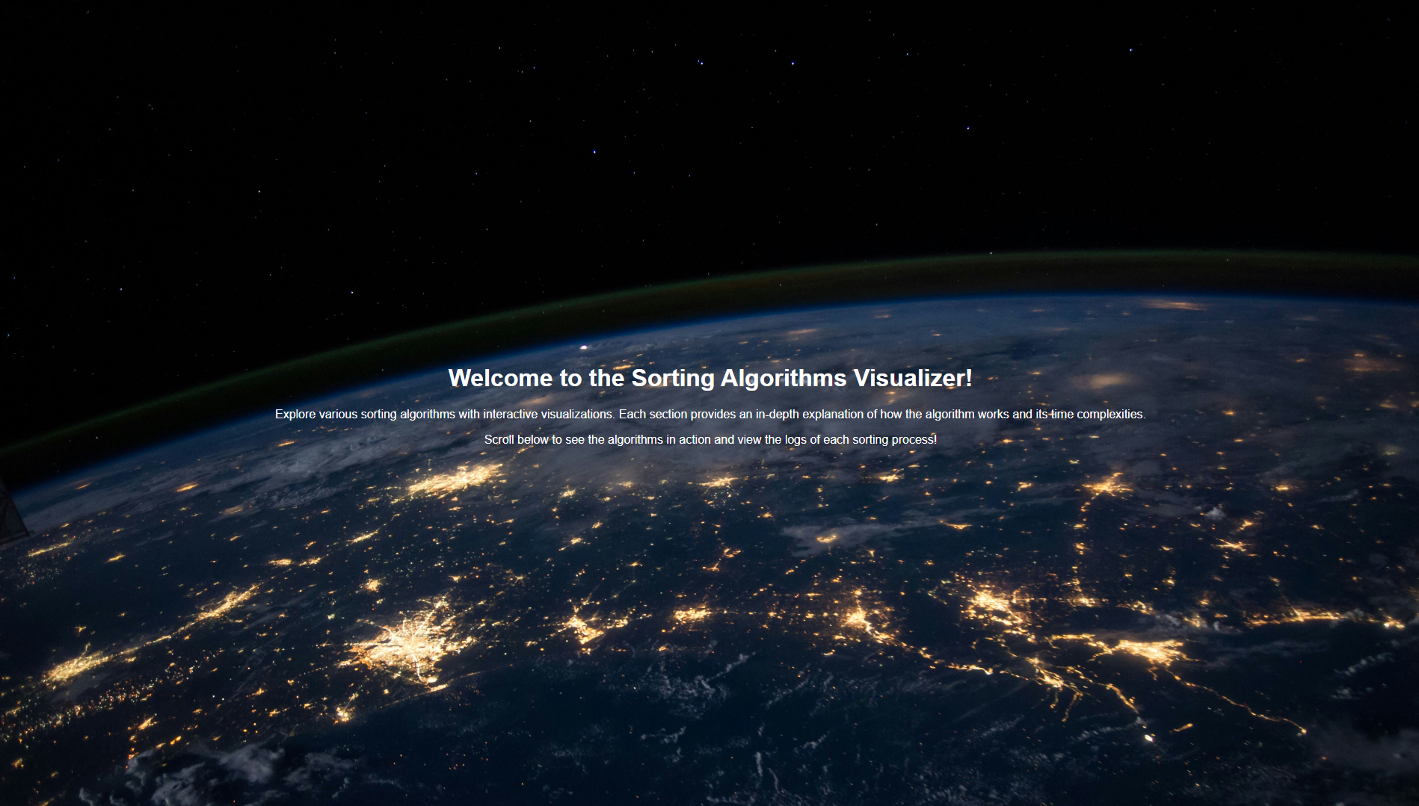
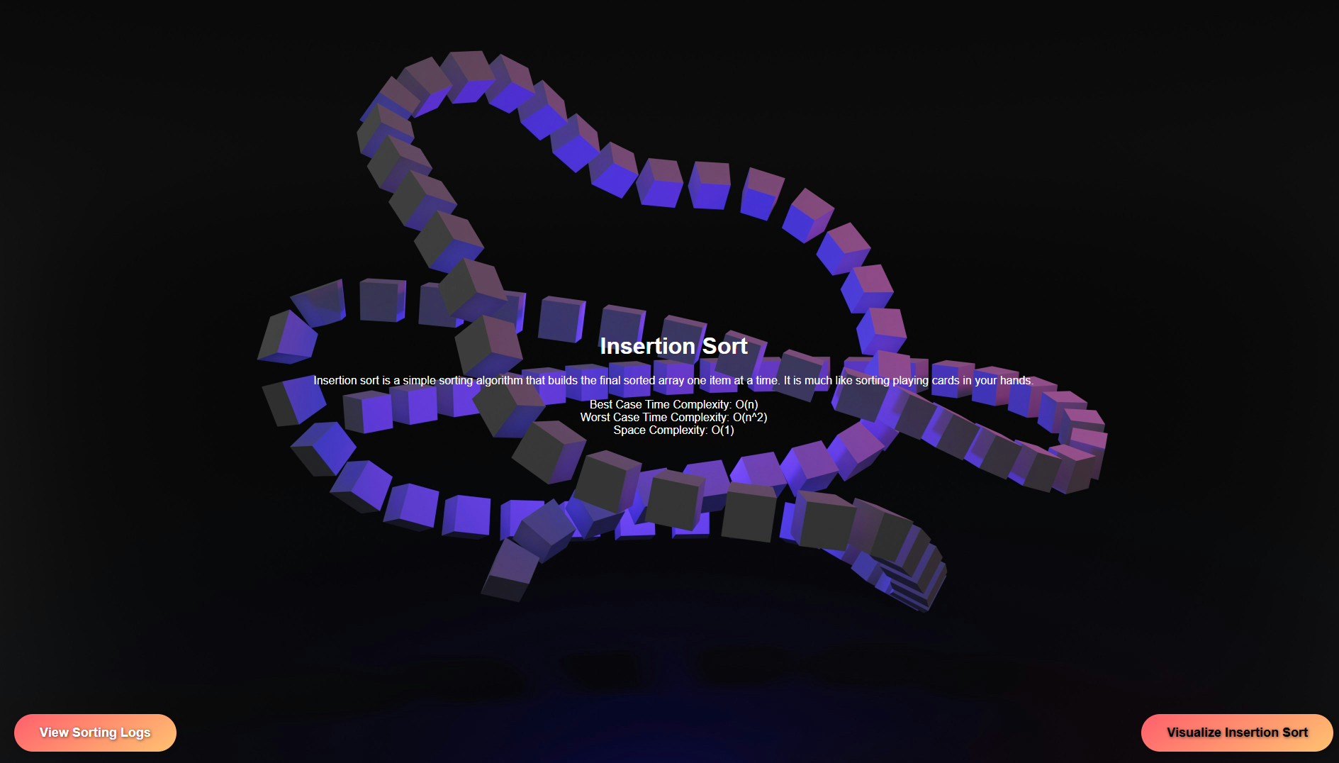
Demo of the working of the algorithms:-
Index Page:-
Algorithm:-

Slide 10
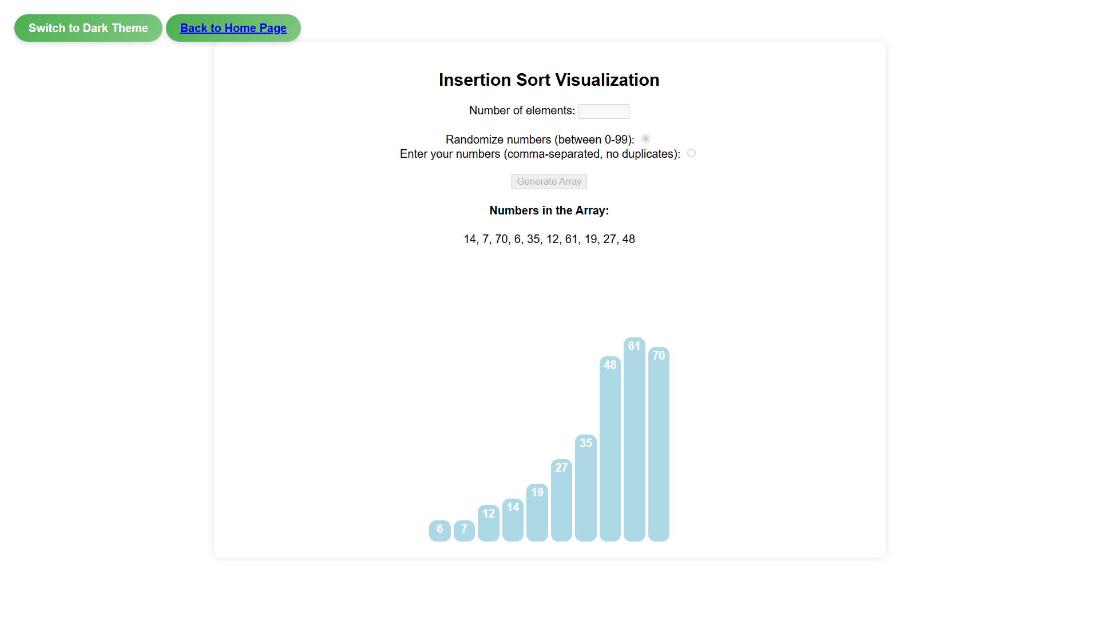
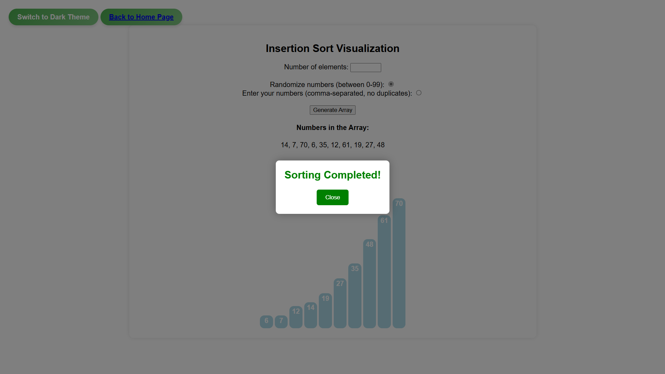
Demo of the working of the algorithms:-
Visualization:-
Sorting Completed:-

Slide 11

Thanks!
Kartik Akbari
akbarikartik0811@gmail.com
Aryan Kothiya
aryankothiya78@gmail.com
Kartik Akbari
Aryan Kothiya

